Slide 1

PRESENTATION ON ADOBE PHOTOSHOP TOOLS

Slide 2
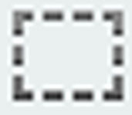

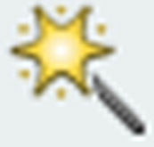
SELECTION TOOLs
Marquee Tools.
Lasso Tools.
Magic Wand Tool.

Slide 3



MARQUEE TOOLs.
Rectangular Marquee Tool
This marquee tool is used to select square or
rectangular area of a picture.
2. Elliptical Marquee Tool
This marquee tool is used to select circular and
oval selection
3. Single Row Marquee Tool
The single row marquee tool is used to select a single row of pixels
4. Single Column Marquee Tool
The tool is used to select a single column of pixels.

Slide 4



LASSO TOOLS
Lasso Tool
The lasso tool is used to create irregularly shaped selection. It includes the lasso for freehand selection
Polygonal Lasso Tool
The polygon lasso tool is used to make selection by drawing a series of straight line to make a polygon shape.
Magnetic Lasso Tool
In this tool you click within the image to start or begin creating your selection and drag the mouse (having released the button) to create selection path.

Slide 5

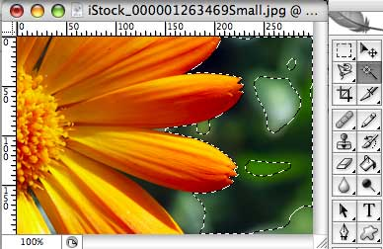
MAGIC WAND TOOL
The magic wand tool lets you to select a consistently colored area (for example , a red flower) without having to trace it’s outline. You specify the color range , or tolerance, for the magic wand tool’s selection

Slide 6
IMAGE EDITING TOOLS
Some of the widely used Photoshop tools are:-
Clone Stamp Tool
Blur Tool
Sharpen Tool
Smudge Tool
Doge Tool
Burn Tool
Sponge Tool

Slide 7

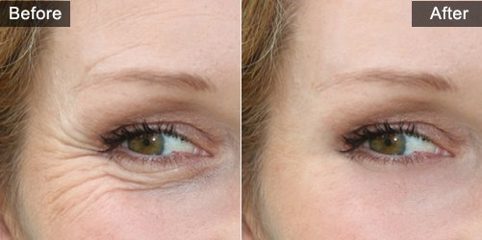
Clone Stamp Tool
The clone stamp tool operates like a brush tool except that rather than selecting a color to paint with you select an area of the image to duplicate or clone by Ait+Clicking the area you wish to duplicate.

Slide 8

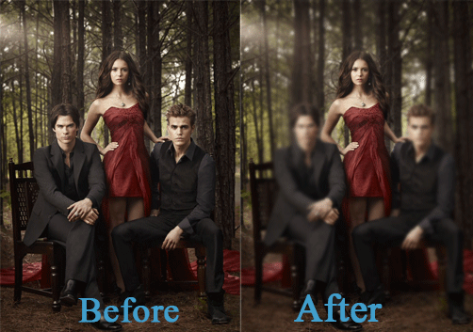
Blur Tool
The Blur Tool is used to blur areas of the images by painting over them. blur tool has various types of the brush being used. The different types of modes are normal, Lighten, Darken, Hue ,Saturation, Color and Luminosity. The Blur Tool is normally used to create mirror images and to make a normal image look like HD image.

Slide 9


Sharpen Tool
The Sharpen Tool is used to sharpen areas and edges of
the image by painting over them. The sharpen tool is
useful primarily for popping out highlight on shiny
objects, or maybe to give an important object a little
extra "pop" after you've though, and always create a
snapshot first because it's so easy to redo it.

Slide 10
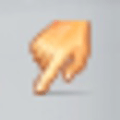
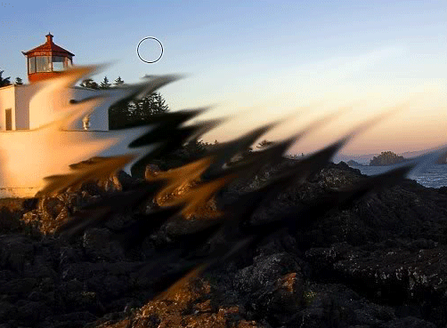
Smudge Tool
The Smudge Tool is grouped with the retouching tool,
but it's actually used more often in painting. For
retouching purposes it can be used to quickly rub out a
minor blemish, touch up the shine on someone, and so
on. It can also be useful for blending out the jaggiest that
can sometime occur when sizing up an image. this is
another tool you want to be careful not to overdo and
be sure to keep the pressure setting low.

Slide 11

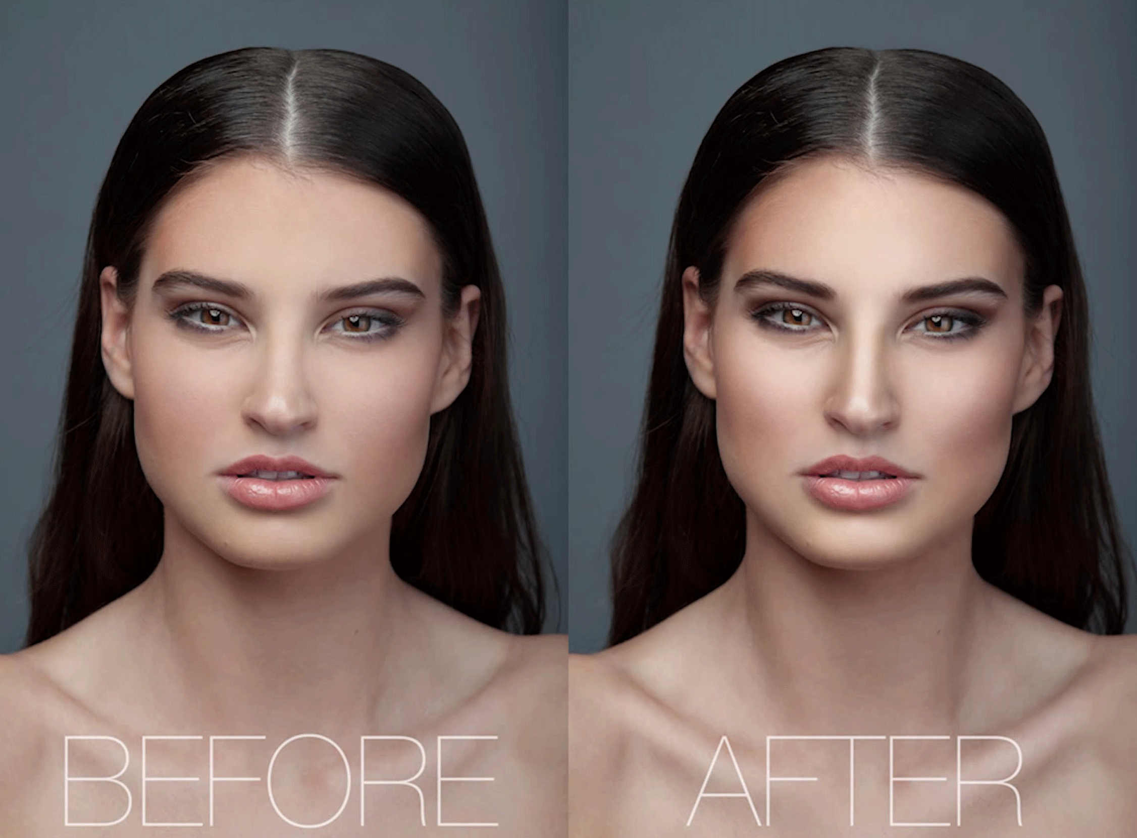
Dodge Tool
The dodge Tool work best on grayscale images. On
color image the dodge tool will wash out color and
details In a grayscale image, this tool is used to lighten
shadows or overexposed area and to darken
underexposed areas. It has a unique option for "range"
with choices of highlights, Mistunes, and shadows. In
grayscale image, one example where the dodge tool is
useful would be for removing dark shadows from under
a person's eyes.

Slide 12

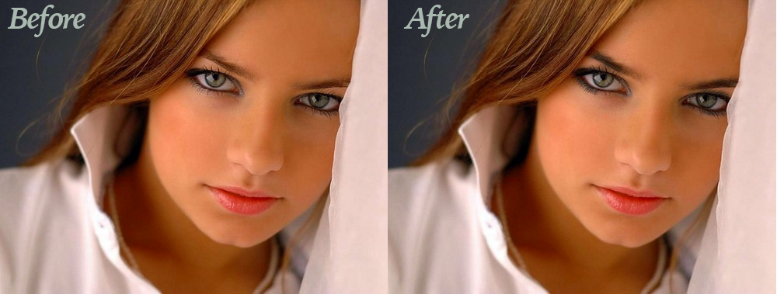
Burn Tool
The Burn Tool also works best on grayscale images. the
burn tool will just turn the area black or sunburned-
looking. In a grayscale image, these tools are used to
lighten shadows or overexposed areas and to darken
underexposed areas. When set to highlight, only the
lightest areas are affected. when set to shadow, only
the darkest areas are affected. When set to Mistunes,
only the middle tones are affected.

Slide 13

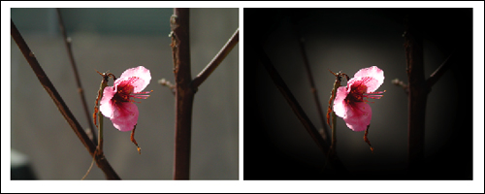
Sponge Tool
The Sponge Tool Allows you to adjust the color saturation where you paint. It has two month: de-saturate and saturate. The pressure option control how strong the effect is applied. De-saturate mode dulls the color, making them grey. saturate mode intensifies the color, making them brighter. In de-saturate mode, the sponge tool is also useful for toning down color in the background of an image when you for giving a color photo a vintage, colorized appearance.

Slide 14
Thank You

